Slide 1

introduction
By: itronics

Slide 2


Slide 3
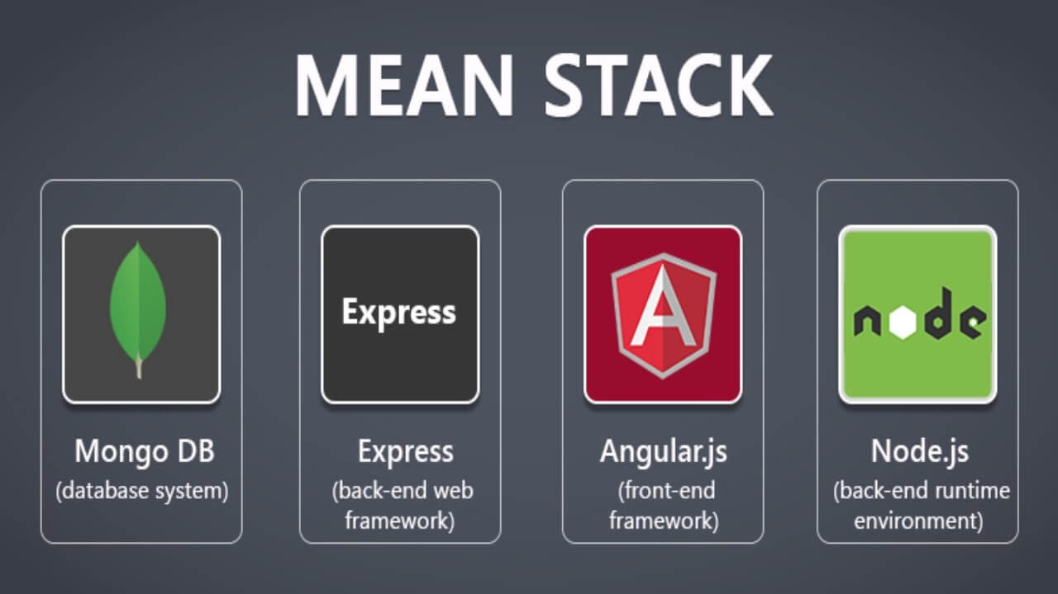

Slide 4
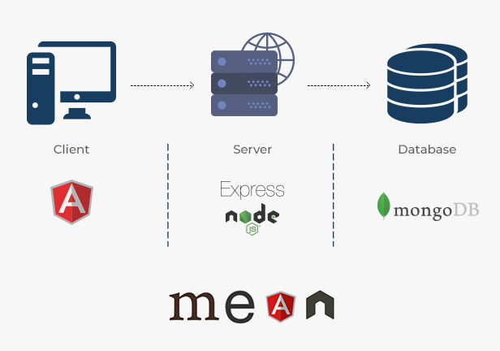


Slide 5
